Slide 1

Credit Card Fraud Detection: Infosys Springboard Project
In this presentation, we'll explore how machine learning can effectively detect fraudulent credit card transactions. We will walk through the process of developing and evaluating a predictive model, highlighting key insights and best practices.
By Vishal Tyagi

Slide 2

Project Overview
Objective
Dataset
Challenges
To detect fraudulent credit card transactions using machine learning models.
Kaggle's Credit Card Fraud Dataset with 284,807 transactions, including 492 fraud cases.
The dataset is highly imbalanced, and accurately classifying rare fraudulent transactions is crucial.

Slide 3

Data Exploration
Dataset Features
31 columns, including Time, Amount, and 28 anonymized variables (V1 to V28). Class: Target variable (0 = Non-Fraud, 1 = Fraud).
Data Characteristics
Highly imbalanced (0.172% fraud cases). No missing values.

Slide 4

Data Preprocessing
Outlier Detection and Removal
Feature Scaling
Feature Selection
Detected 31,904 outliers using IQR. Removed outliers to enhance model performance.
Scaled Amount feature using StandardScaler for model compatibility.
Dropped Time due to low correlation with Class.

Slide 5

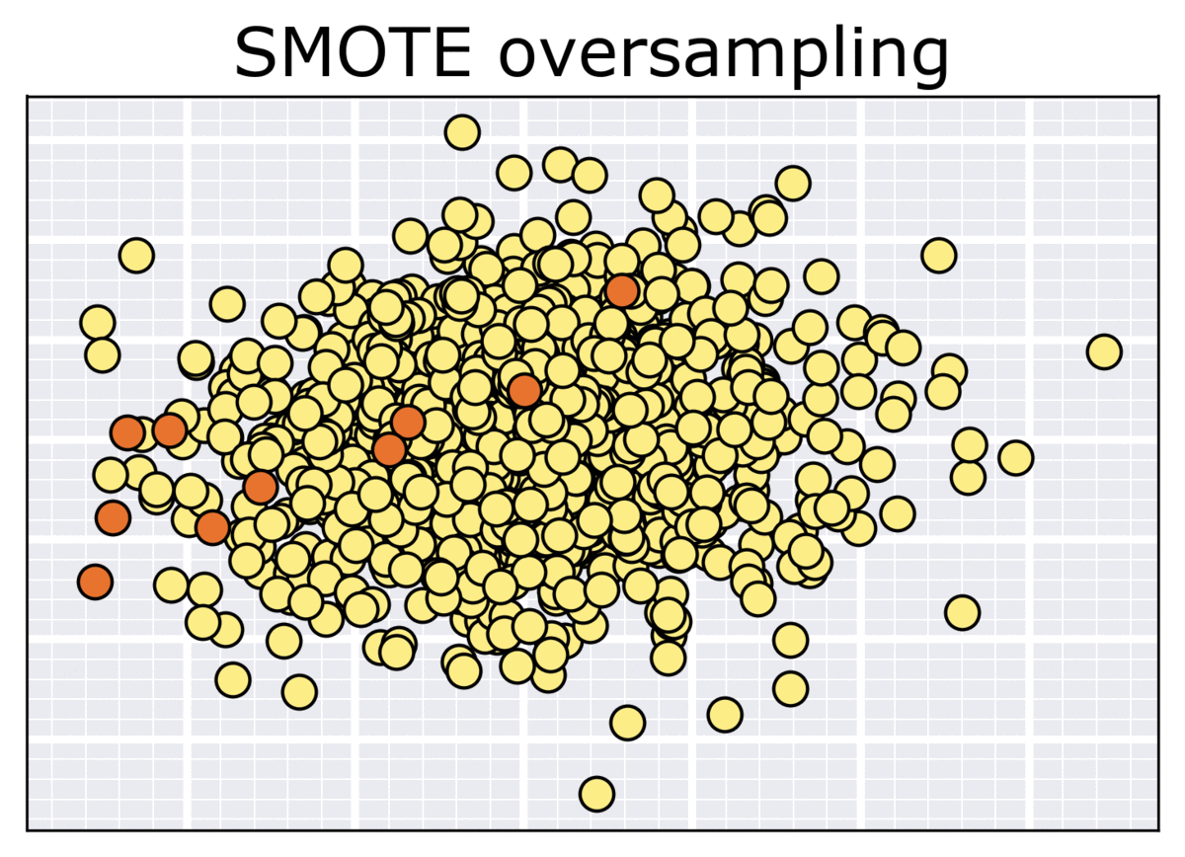
Class Imbalance Handling
Applied SMOTE (Synthetic Minority Oversampling Technique). Resampled dataset to balance classes (202,012 samples each). Improved model sensitivity to fraud detection.

Slide 6
Machine Learning Models
1
Logistic Regression
2
Decision Tree
3
Random Forest
4
XGBoost
5
Support Vector Machine (SVM)
6
LightGBM
7
CatBoost

Slide 7

Evaluation Metrics
Key Metrics
Importance of Metrics
Confusion Matrix, Classification Report (Precision, Recall, F1-Score), ROC-AUC Score, Precision-Recall AUC.
High Recall and ROC-AUC are critical for fraud detection, ensuring that the model can identify most fraudulent transactions.

Slide 8
Results Summary
Model
ROC-AUC
Precision-Recall AUC
F1-Score (Fraud)
Logistic Regression
0.9911
0.7434
0.15
Decision Tree
0.8729
0.6083
0.58
Random Forest
0.9668
0.8523
0.87
XGBoost
0.9756
0.8629
0.84
SVM
0.9827
0.5605
0.23
LightGBM
0.9600
0.8446
0.75
CatBoost
0.9858
0.8492
0.69

Slide 9
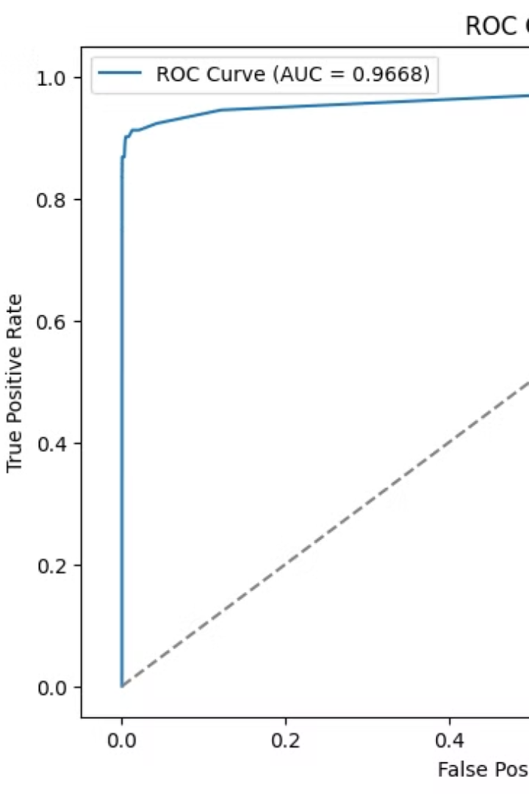
Visualization
Comparison of ROC-AUC Scores
Bar plot highlighting performance of each model.
Precision-Recall Curves
Visualizing model trade-offs between precision and recall.

Slide 10
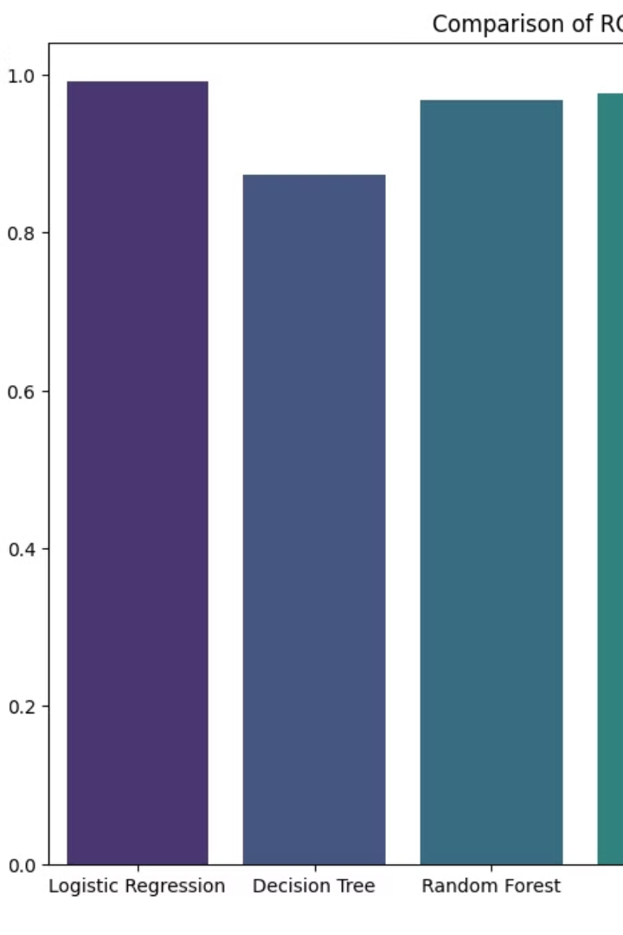
Key Insights
Random Forest, XGBoost, and CatBoost performed best for this dataset.
SMOTE significantly improved fraud detection, balancing precision and recall.
Feature scaling and outlier removal enhanced model performance.

